Slide 1
Creating Value and Opportunities for Growth
Supermarket
Practice Overview

Slide 2
Table of Contents
Our Firm
Industry Challenges
PwC Offerings
  eBusiness
  Enterprise-Wide Cost Reductions
    Shrink Management
    Scheduling and Standards
    Category Management
    IT Systems and Strategies
  Customer Relationship Management
  Talent Management
Sample Resumes of Our Supermarket Practitioners
Supermarket Citations and Corporate References

Slide 3
Our Firm

Slide 4

Our Firm
Audit, Assurance
& Business
Advisory
Services
Tax & Legal
Services
Management
Consulting
Services
Financial
Advisory
Services
Global HR
Solutions
Business
Process
Outsourcing
PricewaterhouseCoopers provides a full line of integrated management consulting services ranging from strategy through implementation
We maintain a deep expertise in our selected markets and bring sustained value through the long term relationships with our clients

Slide 5
Our Firm
PricewaterhouseCoopers is the largest Professional Services Firm in the World
155,000 Partners and Staff - 35,200 Management Consultants
$15.3 billion in revenue
150 years in business services
867 offices in 152 countries
17,200 dedicated Systems Integration staff plus 12,000 ERP professionals

Slide 6
Our Firm: Our Competitive Strengths
Why PricewaterhouseCoopers?
Functional Expertise
Planning/Forecasting
Merchandising
Distribution/Logistics/Allocation
Inventory Management/Replenishment
Customer Service
Financial & Cost Management
Human Resources
Store Operations
Retail Industry Expertise
Extensive industry experience
Required Expertise
Best Practices
Mitigation of Risk
Expeditious Analysis
Performance Improvement Maximization
Retail Software Package Knowledge
JDA
Retek
Intrepid
PeopleSoft
Dallas/EXE
SAP
Oracle
The skills and experience of our consultants provide extensive value to our clients. This value translates into more than just program management expertise, it includes a wide array of capabilities and services
Project Management
Large Projects Experience
Strategic Information Systems Plan
Fast Track Approach
Management Tools
World-wide Capability
Local Staff
Technology Expertise
Planning and Architecture
Custom Development
Package Selection and Implementation
Systems Integration
Quality Management Program
“Manage in” quality at all organizational levels
Reviews conducted early and periodically
Client Service Process (customer feedback mechanism)
Client Expectation Review
Project Quality Review
Post-Closure Review
Merger Integrator
Methodology
Visible Management Techniques
Measurable Financial Targets
Transition Training
Value Based Management
Management Analytics
Established practice providing quantitative analysis consulting services
Over 90 professionals
Experts in statistical analysis, regression analysis, model and algorithm development
Proven methodology
Areas of expertise include on Sales Analysis and Forecasting, Operations Research, Market Analysis, Survey Research
Change Management
Methodology
Best Practices
Practice Tools
Organizational Efficiencies
Strategy
Process Design
Benchmarking
Thought Leadership
Advanced Technology
Centre (Menlo Park)
Reports on New Technologies and Trends
Consults on Technology Decisions
Verifies Software/Hardware Combinations

Slide 7
Our Firm: Our Focus on Retail
Why PricewaterhouseCoopers?
RETAIL
STRATEGIES
RETAIL
BUSINESS PROCESS
RETAIL IT
RESEARCH AND
INTELLIGENCE
RETAIL
THOUGHT LEADERSHIP
We are dedicated to serving your industry. PwC offers a wide range of services that span the retail supply chain and position us as true industry leaders. Our expertise within the retail market sector is globally recognized and trusted ¹
Strategic Planning
E-Business Planning
Operating Strategy Development
International Strategy Development
Organizational Strategy Development
Performance Measurement
New Concept/ Market Development
Turnaround Strategy
Enterprise Wide Cost Reduction Assessments through Implementation
Business Process Assessment
Performance Measurement
Benchmarking
Process Reengineering
Revenue Generation
Best Practices
Strategic Systems Review
Strategic Systems Development
Packaged Software Assessments and Selection
Systems Implementation
Distribution Systems Planning
Operations Review
E-Business Systems Implementation
Economic Analysis and Forecasts
Industry Baseline Analysis
Site-Selection Research
Consumer Research
Due Diligence Assessments
Retail Intelligence System
Consumer Database
Strategic Outlook Conference
Spring Management Conference
Retail Yearbook
Retail Preview
Intelligence Update
The Retail Economist
Critical Issues
¹ The retail industry consulting practice was formerly known as Management Horizons

Slide 8
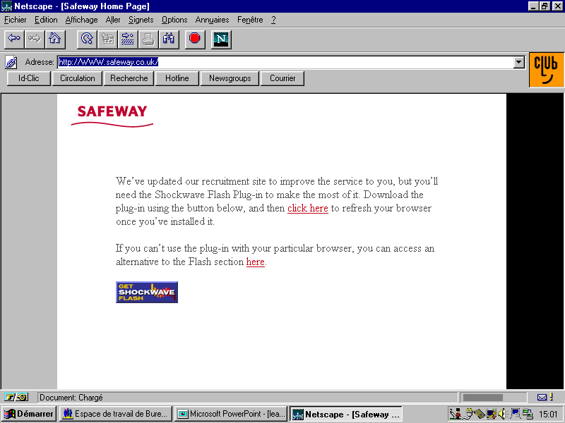












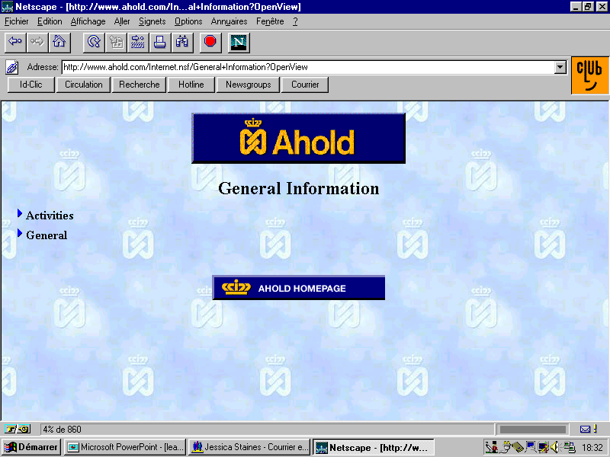
Our Firm: PwC Credentials – Working with the World’s Leading Consumer Goods Retailers

Slide 9
Industry Challenges

Slide 10
Industry Challenges:
The Grocery Industry is Changing Very Rapidly….
Consumer Insight
  Barriers coming down
  Customer retention and loyalty challenge
  Customer Variety
Supply Chain Issues
Competitive Forces
  Wal-Mart Supercenter
  Wal-Mart Neighborhood Markets
  Continued merger activity
CPFR - Collaborative Planning, Forecasting and Replenishment
Category Management
Scan Based Trading/Honor Check-in
Supermarket
Industry
Mature Markets
Consumer Demands
Relatively slow growth and very competitive
Supplier consolidation
Retail Mergers
Convergence
Higher service demands
Product innovation
Choices for delivery
e-Business
Investor expectations
E-particpate decision
B2B and B2E opportunities
B2C Webvan threat
Priceline.com
Need to satisfy stakeholders and investors, grow shareholder value
New evaluation techniques

Slide 11
Industry Challenges: Implications of Those Trends for Your Company…
  Integration of new supply chain economics - pipeline visibility, VMI, eMarket participation to improve reduce costs and GMROI
  Sustained lower cost model and increase in shareholder and economic value
  Development of common processes and ways of working
  Creation of a corporate culture that supports a lower cost of operation
  Consistent execution of performance levels across many business units and initiatives
  Performance improvement as a way of working NOT as a one-off project
  Defense of market share from new retail competitors – convergence of retail formats and direct to consumer
  Maintenance of lower inventories through continuous replenishment and collaborative planning forecasting and replenishment
  Attracting and retaining the best talent for your organization
  Integration of shared services and synergies from mergers and acquisitions
  Development and utilization of your technology capabilities to support all of the above
  In response to those trends PwC has developed specific offerings to help your firm meet those challenges ....

Slide 12
PwC Offerings

Slide 13
eBusiness Offering

Slide 14
PwC Offerings: eBusiness
eMarket strategy will be shaped by three key factors
  Each retailer will have a different starting point, require a different level of integration, and select different service offerings
  Benefits will increase with the effectiveness of back-end integration
  The combination of these variables will determine the level of effort required to connect to an eMarket
Service Offering Selection
Procurement
Logistics
Planning/forecasting
Digital content management
Other Services
Retailer eBusiness Readiness Profile
Existing technology and applications
Use of EDI
Use of Middleware
Skills and resources
Process, organization, and culture
Level of integration
Manual
Batch integration
Real time integration
Speed, Level of Investment & Effort
+
+
=
Implementation tools, change management tools and adoption methodologies, integration tools, and accelerators (e.g., standard plug-in interfaces for major software packages) can simplify and expedite retailer adoption

Slide 15
PwC Offerings: eBusiness
Retailers and Consumer Products Companies are Deriving Significant Value from e-Business
Improve
Efficiency / Speed
Integrate Processes
Reduce Cycle Time
Extend
Reach
Buy-Side
Sell-Side
Suppliers
Enterprise
Wholesalers
Distributors
Retail
Stores
Consumer
e-Procurement
e-Sales / Marketing
Marketing
Product Dev.
Sales
Order Mgmt
Procurement
Production
Distribution
Customer Service
e-Supply Chain
Direct-to-Consumer
Support Processes
Reduce
Processing
Costs
Revenue Enhancement
Customer
Satisfaction
E-HR

Slide 16
PwC Offerings: eBusiness
Our Vision: E-Business Evolution
Retailers are focusing their
… with the ultimate goal
current efforts here …
of being successful here
Restructuring the value chain to create
Industry
“many-to-many” relationships, new value
Transformation
propositions & new business models
Companies entering new industry
sectors and competing outside of
Convergence
their core business areas
Degree of change to business model
Value Chain
Connections with trading partners &
Integration
process changes across the value
chain (buy side / B2B)
Channel
Enhancing current channels
Enhancement
and adding new channels to
market (sell side / B2C)
Enterprise
Internet technology enabled process, systems &
Connectivity
organizational change & getting the organization
connected
Role of E-Business

Slide 17
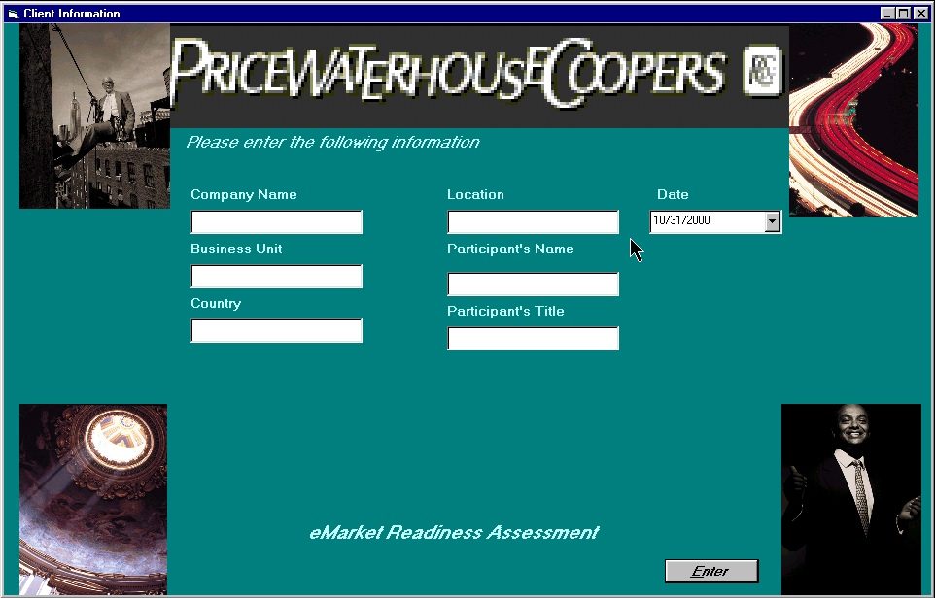
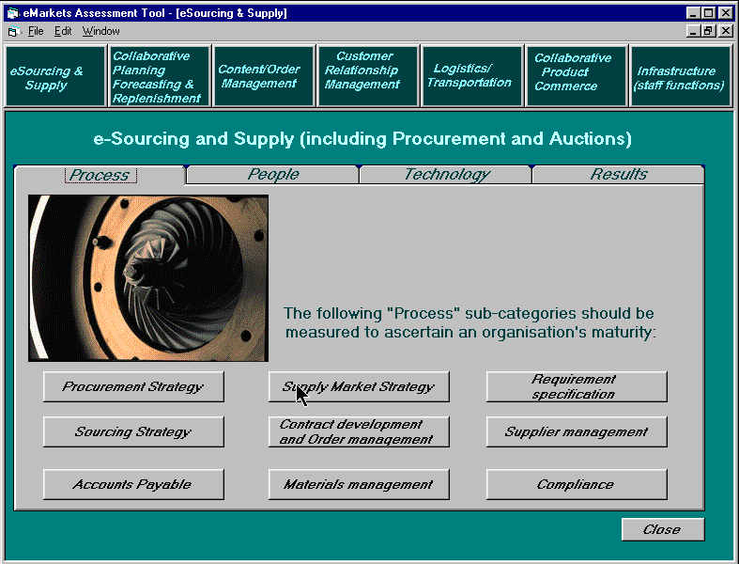
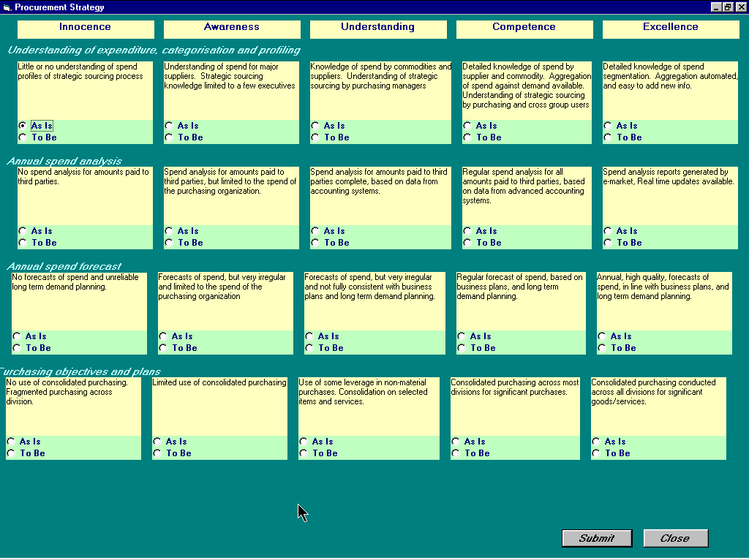
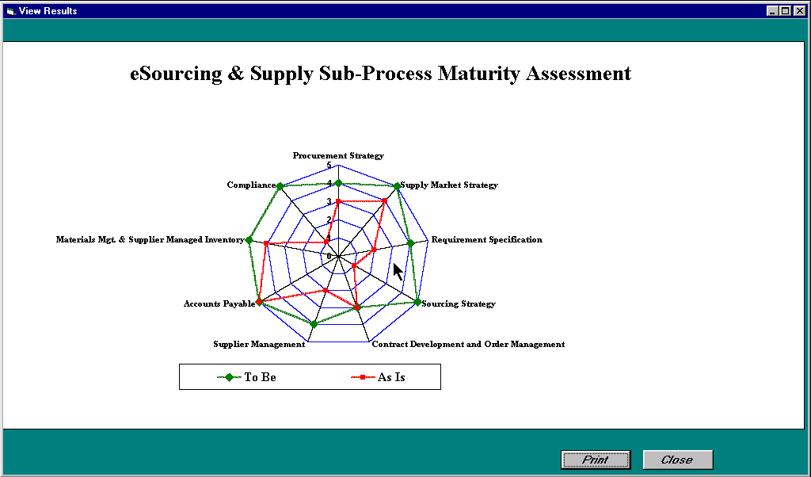
PwC Offerings: eBusiness
PwC’s readiness assessment: are graphical tools for assessing an organization’s readiness for change. (organized around the change levers of People, Process, Organization, Technology)
Illustrative

Slide 18
PwC Offerings: eBusiness
eMarkets will provide a broad range of service offerings that will fall into seven major categories and impact numerous B2B activities
Auctions
Access more suppliers
Reduced product/process costs
Outsourcing HR, IT, etc.
Infrastructure
(HR, Financial, etc.)
eProcurement
(Direct and Indirect)
Better vendor relationships through better data
Lower inventory levels and improved in-stock position
eTrading Partner Relationship Management (eCRM)
Collaborative Planning, Forecasting & Replenishment (CPFR)
Retailer
Collaborative Product Development
Logistics Collaboration
Faster and more market- driven new product introductions
Content & Information Management
Improved fleet utilization
Access to surplus capacity
Digital assets
Item catalogs
Notes:
Stage 1: Build the best platform for conducting business, then entice other vendors to sell through your platform.
Stage 2: Form partnerships with other companies, even competitors, to add services and value to your supply chain.
Stage 3: Consortium of businesses collaborate to plan product development, industry forecasting and planning. Focus on decision support and building collaborative networks and partnerships emphasize new product development.
Source: Business 2.0

Slide 19
PwC Offerings: eBusiness (eMarket strategy)
The decisions to participate in eMarkets in not an “either or” decision. The optimal strategy will involve a blend of public and private eMarkets as well as point solutions. This strategy is dependant upon a company’s individual business model and its core competencies.
Equity
Non-Equity
Public
e-Market
Private
e-Procurement
Do Nothing
Point Solutions
B2B
Demand Planning and Forecasting

Slide 20
PwC Offerings: eBusiness (Value Assessment)
Phase 1: eMarket Value Opportunity
Phase 2: Build eMarket Participation Strategy
Initiate
and
Research
Assess
eMarket
Opportunities
Determine Gaps
with Current
Capabilities
Build eMarkets
Integration
Roadmap
Value Assessments provide an understanding of the value of specific opportunities and provide insight into implementation requirements
  Provide insight into the potential value of specific eMarket products and services
  Offer recommendations on where to focus implementation efforts, including key internal process, organisational, and systems changes required
  Identify next steps and quick hits that can be addressed immediately
  Help build commitment and momentum within the organization
For retailers that haven’t joined an eMarket, a Value Assessment is an important step in developing its eMarket strategy

Slide 21
Typical Timeline: eBusiness (Value Assessment)
Phase 1: eMarket Value Opportunity
Phase 2: Build eMarket Participation Strategy
Initiate
and
Research
Assess
eMarket
Opportunities
Determine Gaps
with Current
Capabilities
Build eMarkets
Integration
Roadmap
2 - 3 weeks
2 - 4 weeks
Identify critical company processes, technology, and organization models
Understand company core competencies
Identify process owners and stakeholders
Quantify potential value from B to B initiatives
Capture and quantify listing of current planned initiatives and improvements
Begin to build organizational consensus on”desired end state” and applicability of various potential B to B initiatives
Determine gaps in current processes, technology, and organization versus “desired end state”
Develop organizational consensus around priorities for improvement
Communicate an implementation strategy including high-level resource requirements and cost estimates
Build performance measures and tracking process to support an eMarket implementation strategy
Objectives
Schedule Opportunity Assessment and Capability workshops
Provide background on eMarkets
industry landscape
Identify participating resources
Conduct senior management interviews
Initiate data requests
Conduct Opportunity Assessment workshop to prioritize products / services and determine desired “end state”
Understand current initiatives
Identify a range of potential value, using PwC’s eMarkets Value Calculator
Conduct Capability workshops using detailed eMarkets maturity profiles for priority products and services to evaluate current capabilities
Determine appropriate level of integration and customization
Evaluate client’s “appetite” for change
Complete gap assessment between desired “end-state” and client’s current capabilities
Identify, and prioritize,
projects on eMarkets roadmap
Define implementation strategy
Develop high-level resource model and cost estimates
Identify potential areas of risk
Define performance measures and develop process for tracking benefits
Key Tasks
Source: Value Assessments

Slide 22
PwC Offerings: e Business (Value Assessment)
At the PwC website, www.pwcglobal/retail, a quick version Value Assessment Questionnaire can be completed. You will get an almost instant feedback, and then we will be able to help you unlock the eMarket value for your firm.
Purchasing of Goods and Services Not for Resale
1. How is the procurement process organized for indirect purchasing?
Multiple, Decentralized Units 1 2 3 4 5 Single Centralized Organization
2. What is your vendor structure for indirect purchasing?
Many Opportunistic Relationships 1 2 3 4 5 Few Strategic Partners
3. What is the quality and frequency of purchase orders?
Many Small Orders 1 2 3 4 5 Few Large Orders
Purchasing of Goods For Resale
1. How would you categorize your vendor relationships?
Many Opportunistic Relationships 1 2 3 4 5 Few Strategic Partners
2. How would you categorize your product assortment?
Seasonal 1 2 3 4 5 Commodity / Basic
3. What is your promotional strategy?
Special, One Time Buys 1 2 3 4 5 From Current Assortment
4. Identify the variability of demand
Systematic and Stable 1 2 3 4 5 Highly Promotional and Seasonal
Data Exchange
1. Characterize your Data Exchange Needs
Few Partners, Few Data Elements 1 2 3 4 5 Many Partners, Many Data Elements
2. What is your Current Method of Exchange
XML/ Web Based 1 2 3 4 5 Flat File/ EDI

Slide 23







PwC Offerings: eBusiness (Trade Exchange Participation)
✓
✓
✓
Other commodity
Verticals
Other Retailers
INC2inc
Global Foods Exchange
Chevron C Stores
Rooster.com
Commodity Verticals
Consumer Product Verticals
Output Verticals
Citibank
Horizontals
Nestivo
Other
Notes:
Speaker - Rick
Points:
On supply side no dominance
Ready made dominance in CPG manufacturers space
CPG Market procurement based, not global - our investors will not accept a regional solution
Little guys begging to be bought
If we fail, retail will dominate us
Do you want them to own item catalog?
Wal-Mart playing ball
GNX fully on board with vision - CONNECT THRU TRANSORA
WWRE schizophrenic - VICs and UCC.net
Small retailers interested
Horizontals begging for connection
Messages
Transora has already won.
Don’t give away this gift

Slide 24
PwC Offerings: eBusiness (B to C Publishing)
Business to consumer publishing can evolve from intuitive decisions to a combination of mass merchandising (best sellers, highest gross margin) and micro merchandising (previous customer shopping pattern). This migration is dependant upon data availability and will require a shift in the organizational decision making process.
To-be state examples
Decisions based upon clearly articulated mass merchandising and automated (“dynamic”) micro merchandising
Content updates are managed automatically using organization-wide and explicit criteria and associated information.
Net Perceptions cross-sales recommendations
Availability of data
& validated customer shopping patterns
Decisions driven by combination of objective mass merchandising data and subjective decisions (“static”)
The process for updating content is increasingly standardized as the organization agrees to key criteria and as information delivery is automated. Automation is not yet feasible, as subjective criteria enter into the decision-making process.
Merchandising and marketing content selected with the benefit of additional information
Decisions driven by intuition & exogenous data
Aesthetic site makeup and customer-product relationships
In this stage, content updates are managed by each individual’s knowledge and perception. Criteria for taking action are clouded by a limited fact base.
Organizational readiness

Slide 25
Why You Need to Conduct an eParticipate discussion
Ask yourself the following questions:
  What are the costs and returns you expect from eParticipation?
  What happens to your existing initiatives?
  Is your organization ready to participate in eMarkets?
  How does the eParticipation landscape look?
  Who do you have to interface with?
  How will you maximize value from your eParticipation?
  Which eParticipation service offerings make the most amount of sense for you?
  How difficult is it to implement eParticipation outcomes and trading practices?
  If you find it difficult to answer these questions , an eParticipate strategy discussion with PricewaterhouseCoopers would be very valuable to your organization

Slide 26
Enterprise Wide Cost Reduction - Offerings

Slide 27


PwC Offerings: Enterprise-Wide Cost Reduction
Reduce
Costs
(Shrink
Management)
$
$
Improve
Processes
(Scheduling
and Standards)
Store Operations
Supply Chain/WMS
Sustainable through:
Actual implementation
Embedded in performance measures
Driven by a proven change management methodology
Support
Growth
plans
Based on Strategy
Category
Management
(Inventory
Management)
Leverage
Technology
(Automated
Scheduling and
Ordering)

Slide 28
PwC Offerings: Enterprise-Wide Cost Reduction
We take a proven, structured, approach comprising phases from issue diagnosis through final delivery and embedded improvements
Develop
Implementation
Design
Deliver
Benefits
Diagnose
Issues
Establish
Baseline
Assess
Opportunities
Develop
Improvements
Embed
Improvements
Value
proposition
Selected
Focus
areas
Quantified
performance
gap
New performance
and cost management
processes
Business case for closing the gap
Detailed
improvement
specification
and schedules
Measurable
Benefits
Change Management Methodology

Slide 29
EWCR Shrink Management - Offering

Slide 30
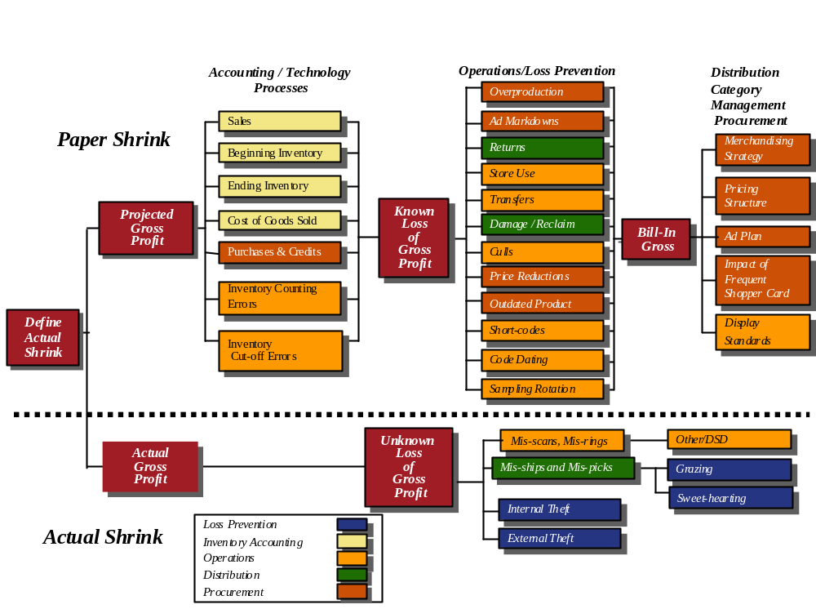
PwC Offerings: Enterprise-Wide Cost Reduction - Shrink Management
Diagnose
Shrink
Issues
Establish
Current
Shrink
Baseline
Assess
Opportunities
To Manage
Shrink
Develop
Improvement
Initiatives
Implement
Shrink
Initiatives
Embed
Improvements
The PwC Shrink Diagnostic framework looks
at all of these areas

Slide 31
PwC Offerings: Enterprise-Wide Cost Reduction - Shrink Management
Diagnose
Shrink
Issues
Establish
Current
Shrink
Baseline
Assess
Opportunities
To Manage
Shrink
Develop
Improvement
Initiatives
Implement
Shrink
Initiatives
Embed
Improvements
The PwC team focuses on understanding the current state at the client and digging beyond shrink symptoms to clarify root causes
  This enables our team to identify significant opportunities for simplifying processes that contribute to paper shrink
  Our holistic approach of reviewing end to end processes covers the impact of store operations, work methods, technologies, and other factors that affect true shrink management
  The team interprets their observations and interview findings and compares those findings to actual practices (execution) to corporate operating procedures
  With this level of understanding, PwC will then define the gaps in current state and industry best practices that will provide our client with direction and key shrink management opportunities
  PwC will identify the areas in which a greater focus will yield the most significant results for our client

Slide 32
II. Typical Shrink Management Project Objectives and Scope
Diagnose
Shrink
Issues
Establish
Current
Shrink
Baseline
Assess
Opportunities
To Manage
Shrink
Develop
Improvement
Initiatives
Implement
Shrink
Initiatives
Embed
Improvements
The following areas are typically included in our shrink diagnostic:
  Store Operations
  Inventory Accounting
  Distribution
  Procurement and Category Management
  Information Technology
  Loss Prevention
The following objectives are addressed during the first phase of the project:
  Benchmark client shrink performance versus comparable retailers
  Identify gaps in process, people, and technology that contribute to current shrink results
  Provide potential solutions, strategies and recommendations to address those gaps
  Describe recommended program and next steps for defining reasonable targets and effectively managing shrink

Slide 33
Typical Timeline
Diagnose
Shrink
Issues
Establish
Current
Shrink
Baseline
Assess
Opportunities
To Manage
Shrink
Develop
Improvement
Initiatives
Implement
Shrink
Initiatives
Embed
Improvements
Pre Kick-off Planning Session and Project Kick-off -1 week
Complete the diagnostic
- 4 weeks
Complete the analysis and document the findings -2 weeks
Finalize work-plan and set key dates
  Interviews & Observations
  On-site visits
  Inventory reviews
  Agree on Deliverables
  Assemble project team
Gain understanding of the overall shrink factors
Clarify key gaps in process, people and technology that create shrink
Complete analysis of data collected
Document findings
Prepare presentation and final document
Complete recommendations
Objectives
Interviews
Observations at multiple locations: FAS, DC, procurement
Data gathering & analysis
Benchmarking
Comparison to best practices
Introduce project team
Determine key milestones and communication model
Resolve any open issues or questions
Sign engagement letter
Create final deliverable
Input benchmarking data
Hold Brainstorming sessions
Present draft of presentation
Present deliverable, next steps
Key Tasks

Slide 34
Why You Need to Conduct a Shrink Diagnostic
Ask yourself the following questions:
  Are your sales growing but your gross profits continue to decline?
  Are your shrink numbers growing?
  Do you find it difficult to quantify the impact of shrink on your business?
  Do you have difficulty understanding your shrink numbers by department and category?
  Do you currently invest in electronic article surveillance systems, closed circuit TV, and in store detectives to manage theft? But you are skeptical about how well those measures really work?
  Is is hard with your turnover to keep store level people trained to deter theft?
  Do your people spend a lot of their time researching poor inventory results every quarter?
If your answer to these questions is yes, a Shrink Management Diagnostic from PricewaterhouseCoopers would be very valuable to your organization

Slide 35
EWCR Scheduling and Standards - Offering

Slide 36
PwC Offerings: Enterprise-Wide Cost Reduction - Scheduling & Standards
Diagnose
Current
Scheduling
Issues
Establish
Current
Performance
Gaps
Assess
Standards
and
Scheduling
Approach
Refine
Standards
and
Scheduling
Configuration
Implement
Revised
Processes
Embed
Improvements
with
Operational
Binder
Developing labor standards can be a time consuming and expensive proposition. Before this process is undertaken, the approach should be well thought out to consider challenges such as the following:
  To what level of detail should the standards be developed?
  Is there consensus within the company on best practice work methods?
  Has a service level standard been established for the checkout operation?
  Are consistent work methods being employed presently within the organization?
  Will the standards be used to evaluate individual employee performance?
  How will the standards be utilized in the creation of store operating budgets?
  Will the standards be used in forecasting labor to generate employee schedules?
  What standards format is required for use in evaluating employee performance, labor scheduling, and the budgeting process?
  Can labor standards possibly be purchased from industry associations, share groups, or other external sources?

Slide 37
PwC Offerings: Enterprise-Wide Cost Reduction - Scheduling & Standards
Diagnose
Current
Scheduling
Issues
Establish
Current
Performance
Gaps
Assess
Standards
and
Scheduling
Approach
Refine
Standards
and
Scheduling
Configuration
Implement
Revised
Processes
Embed
Improvements
with
Operational
Binder
Begin the following process to develop internal labor standards that are meaningful:
  Define and document the accepted procedure for each job
  Gain consensus from stakeholders (Merchandisers, Specialists, Supervisors)
  Communicate the standards to Staff, Department & Store Managers, & Supervisors
  Assure that relatively consistent work methods are being employed across the chain
  Determine how the standards are to be expressed for future use within the organization (e.g. items / minute or minutes per item, etc.)
  Select representative store locations considering facilities, equipment, & product mix
  Determine the number of time study observations to be completed
  Conduct live time study observations
  Recap time study findings factoring in delays and breaks to establish work standards
  Establish an ongoing process for standards update as operating practices evolve

Slide 38
PwC Offerings: Enterprise-Wide Cost Reduction - Scheduling & Standards
Diagnose
Current
Scheduling
Issues
Establish
Current
Performance
Gaps
Assess
Standards
and
Scheduling
Approach
Refine
Standards
and
Scheduling
Configuration
Implement
Revised
Processes
Embed
Improvements
with
Operational
Binder
Once labor standards have been established, they are available for use within a labor scheduling system after determining:
  Whether or not the labor scheduling system already exists internally or if a vendor search must be initiated
  Which departments are to be included in the labor scheduling system
  Scheduling increments for each department (15 or 30 minute intervals, hourly, daily)
  The method in which scheduling drivers such as historical customer and item counts will be captured and input to the labor scheduling system on an ongoing basis
  Identification of fixed tasks
  Identification of variable tasks
  Necessary work rules relative to employee scheduling that must be incorporated
  Ongoing method and frequency of updating the scheduling drivers
  Links to performance reporting and budgeting processes and training requirements

Slide 39
PwC Offerings: Enterprise-Wide Cost Reduction - Scheduling & Standards
Diagnose
Current
Scheduling
Issues
Establish
Current
Performance
Gaps
Assess
Standards
and
Scheduling
Approach
Refine
Standards
and
Scheduling
Configuration
Implement
Revised
Processes
Embed
Improvements
with
Operational
Binder
An effective Labor Management System provides management with timely payroll performance related information that is usually independent of the Scheduling System featuring:
  A tool enabling the Store Manager to “cost” the schedule for any given week that considers each Associate’s average hourly rate along with their particular schedule
  Real time query capabilities to report week to date payroll performance at both a department and sub-department level
  Actual payroll dollars spent versus budgeted by department and by store
  The calculation of an “earned” payroll metric on the basis of the actual workload versus the projected workload for each week
  Associate Key Performance Indicators (KPIs) such as cashier scans per minute
  Total store KPIs such as SPLH, Payroll Percent, Overtime, Average Hourly Rate (AHR), Part Time / Full Time ratio, etc.
  A link to the financial system enabling the development of standards based budgets
  The capability to model anticipated process and / or equipment changes to determine the impact upon payroll

Slide 40
Why You Need to Conduct a Labor Standards Diagnostic
Ask yourself the following questions:
  Is you workload within your departments often unbalanced ?
  Are you checkout lines often long?
  Are your Associates frustrated with their ability to get the job done in the allotted time?
  Is your employee turnover rate excessive compared to similar businesses?
  Do you receive excessive numbers of customer complaints about poor service levels?
  Have your labor standards failed to evolve over time with changes in the store operation?
  Do your shrink numbers exceed the industry norm?
  Do your employee productivity achievements vary widely within any given week?
  Are your work methods inconsistent from store to store from division to division?
If your answer to these questions is yes, a Labor Standards Diagnostic from PricewaterhouseCoopers would be very valuable to your organization

Slide 41
EWCR Category Management -
Offering

Slide 42
Typical Timeline - Category Management - Assessment of Current Capabilities
Diagnose
Issues
Establish
Baseline
Assess
Opportunities
Develop
Improvements
Implement
Category
Management
Initiatives
Embed
New Program
and
Processes
Pre Kick-off Planning Session and Project Kick-off -1 week
Complete the diagnostic
4 -6 weeks
Complete the analysis and document the findings -2 weeks
Finalize work-plan and set key dates
  Initiate project
  Agree on current category management capabilities
  Agree to customer management/category management vision
  Develop migration plan
  Develop and deliver category management training to senior management and practitioners
  Assess current category management processes and methods
  Assess current organizational structure & skills to support category management
  Assess current information systems to support category management
Complete analysis of data collected
Document findings
Prepare presentation and final document
Complete recommendations
Objectives
Key Tasks
Interviews
Observations
Category Management Key Tasks
Procurement
Data gathering & analysis
Benchmarking
Comparison to best practices
Introduce project team
Determine key milestones and communication model
Resolve any open issues or questions
Sign engagement letter
  Collect and tabulate category management scorecard
  Conduct interviews with key personnel
  Collect category management performance data
  Evaluate current capabilities

Slide 43
PwC Offerings: Category Management Implementation
Diagnose
Issues
Establish
Baseline
Assess
Opportunities
Develop
Improvements
Implement
Category
Management
Initiatives
Embed
New Program
and
Processes
Objectives
  Based on the findings of the diagnostic/ assessment the following implementation approach would be the next step
  Develop training module for senior management on category management concepts and principles
  Deliver training module to senior management
Key Tasks and Considerations
In this phase the project team will:
  Assemble industry best practices in category management
  Develop training modules covering category management history, concepts, best practices, organizational implications and benefits
  PwC will deliver training modules to senior management in a one day workshop
Key Deliverables
  Fully developed category management overview training program
  Delivery of training program to senior executives

Slide 44
PwC Offerings: Category Management Implementation
Diagnose
Issues
Establish
Baseline
Assess
Opportunities
Develop
Improvements
Implement
Category
Management
Initiatives
Embed
New Program
and
Processes
Category Specific Tasks and Considerations
In this phase the project team will:
  Execute all seven steps for each category based on preliminary definitions
  These category reviews will be facilitated by PwC the first time to ensure the new methodology is internalized by the clients practitioners
  This exercise will reinforce the development of the skill sets and expertise within the clients own resources
  In this step PwC builds on the initial training modules and ensures that the new methodology is put into practice
  then support the category managers as they execute a complete category review
I. DEFINE CATEGORY
Develop Category Review Calendar
Conduct Consumer Research
Define Category Structure
II. CATEGORY ASSESSMENT
Review Assortment Effectiveness
Review Shelf Layout Effectiveness
Review Pricing Effectiveness
Review Promotional Effectiveness
III. CATEGORY POSITIONING
Develop Category Roles
Develop Category Strategies
IV. CATEGORY GOALS
Define Category Performance Metrics
Define Category Performance Goals
V. CATEGORY TACTICS
Define Assortment Tactics
Define Shelf Layout Tactics
Define Pricing Tactics
Define Promotional Tactics
VII. PLAN IMPLEMENTATION
Define Implementation Schedule
Define Implementation Responsibilities

Slide 45
Why You Need to Conduct a Category Management Diagnostic
Ask yourself the following questions:
  Is less time spent on category plan implementation than on category planning?
  Do your people hesitate when asked to explain the roles of your top categories?
  Are your plan-o-grams under-compliant in your stores?
  Are you over-spending some weeks and find the spends in non-destination categories?
  Are your category managers’ promotion plans for effective promotions too loosely articulated?
  Are key suppliers coming to you with last minute large opportunities for categories?
  Do your category managers struggle to explain customer purchase behavior in key categories?
  Is private label business constantly under attack by manufacturers and left under protected?
If your answer to these questions is yes, a Category Management Diagnostic from PricewaterhouseCoopers would be very valuable to your organization

Slide 46
EWCR IT Systems & Strategy - Offering

Slide 47
IT Systems and Strategies
Insight
Architecture
Investment
Closure
CUSTOMER
Value Creation
BUSINESS STRATEGY
Enables & Implements
Value Creation
BUSINESS PROCESSES
Supports Processes & Creates
Strategic Opportunities for:
IT STRATEGY
Making decisions
Executing transactions
Measuring and reporting performance

Slide 48
IT Systems and Strategies
Insight
Architecture
Investment
Closure
HIGH
Few Companies -
Enables Business Transformation
Some Companies -
Supports Basic Business
Value Creation
Many Companies -
Minimal Value Creation
NEGATIVE
LOW
Technology Spending
HIGH

Slide 49

IT Systems and Strategies
Insight
Architecture
Investment
Closure
Create Business Strategy
Align Drivers of IT
Investment Decisions
Define Resultant IT
Investment Proposition
Develop a
Strategy
Vision
Consensus
Decision and actions about
technology investments must
focus on:
Financial
Structure
Enterprise
Value Creation
Industry
Value Chain
Alignment with
business strategy
Strategy implementation
and value creation
Defining opportunities for
IT to transform the business
Products
Markets
Basis for
Competition
Reduced
Time to Realisation

Slide 50
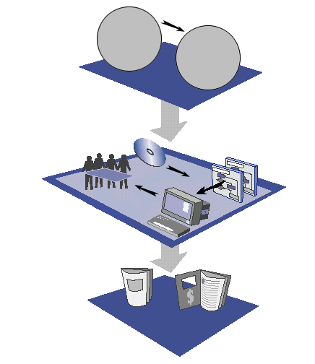
IT Systems and Strategies
Drives business
process design
Business Strategy
The approach to
creating value
Business Processes
The tactical enablers
of business strategy
Information
Information content and form
for decision making, financial
transactions, and control of production,
distribution and consumption
ALIGNMENT
Applications
Solutions for information management
and transaction automation
Organisation / Governance
Management principles, processes, roles,
and responsibilities
SOURCING - who
TOPOLOGY - where
ARCHITECTURE
Technology
Technology platforms,
techniques and tools
Implementation
Prospectus
Business
Case
INVESTMENT

Slide 51
IT Systems and Strategies: Ascendant© IT Strategy Methodology
The methodology consists of the four phases and ten project stages:
Insight
Architecture
Investment
Closure
Assess
Current IT
Understand
Strategy and
Positioning
Construct
Conceptual
Architecture
Commit to
Strategic
Solutions
Construct
Implementation
Architecture
Publish
Strategic
Investment
Prospectus
Establish Change
Management
Program
Establish and
Operate
Program Office
Closure
Develop
Process
Insight
The PricewaterhouseCoopers Ascendant© IT Strategy methodology recognizes the need to examine all areas within the IT domain; Hardware, Software and Resources.
Our methodology helps clients to realize strategic change using technology by:
  Providing insight into IT capabilities and their impact on the business
  Constructing implementable IT architectures
  Managing the investments to achieve the agreed strategy and architecture in a dynamic environment

Slide 52
IT Systems and Strategies: Ascendant© IT Strategy Methodology
This methodology defines a framework that, when used in conjunction with trained and experienced project personnel, assists a business in achieving a successful and effective approach to technology strategy projects.
This methodology provides viable and practical solutions to the four primary issues surrounding technology strategy projects:
  What needs to be done?
    Defines a comprehensive set of tasks that identify the activities to be completed, the work products to be produced, and the other outcomes to be achieved
  When should it be done?
    Defines a sequence in which the tasks should be completed
  How should it be done?
    Describes a range of tools and techniques that are appropriate to use at specific points in the development process
  How should it be controlled?
    Provides project management and quality review points as well as defining control activities throughout the process

Slide 53
IT Systems and Strategies: Ascendant© IT Strategy Methodology
The objectives of the methodology include the following:
  Identify information systems and technologies that will creatively maximize benefit to the business
  Define a software process that focuses on the business
  Take an enterprise-wide view of the organization in developing system solutions that reflect real business opportunities and needs
  Provide a consistent and orderly approach to developing a technology strategy that meets the needs of the business
  Monitor and control project resources to identify cost-effective systems architecture and implementation plans that are delivered on schedule and within budget

Slide 54
Why You Need to Conduct a Strategic Information Systems Plan
Ask yourself the following questions:
  Does your IS department have a strategic planning process that prioritizes projects based on need and ROI?
  Do you know how your spend on IT compares to others in your industry?
  Do you know how your IT capabilities measure up against your competition?
  Do you believe your investment in IT is providing the maximum benefits?
  Do you have a process in place to select new technologies?
  Do you have a process in place to ensure proper implementation of new technology?
  Do you believe you IT department operates as an enabler to your overall business?
If your answer to these questions is no, executing a Strategic Information Systems Plan with PricewaterhouseCoopers would provide value to your organization

Slide 55
Customer Relationship
Management - Offering

Slide 56
Customer Relationship Management: Customer Relationships and Level of Interaction
Diagnose
Issues
Establish
Baseline
Assess
Opportunities
Develop
Improvements
Implement
Customer
Relationship
Initiatives
Embed
New Program
and
Processes
Category Management
Relationship is consumer focused and customer driven
With a collaborative effort of multifunctional teams
Precision Marketing
Level 3
Category
Management
Category Development
Relationship involves Strategic Business
Planning, SKU analysis and Category Reviews
Fact based selling
Category investigation.
Level 2
Category
Development
Sales
Relationship is market driven with price and promotion as the key elements.
Fact Based selling is used against identified business opportunities
Issue is just looking at category management
Sales level analysis or category development
Level 1
Sales

Slide 57
Typical Timeline - Customer Relationship Diagnostic
Diagnose
Issues
Establish
Baseline
Assess
Opportunities
Develop
Improvements
Implement
Customer
Relationship
Initiatives
Embed
New Program
and
Processes
Pre Kick-off Planning Session and Project Kick-off -1 week
Complete the diagnostic
4-6 weeks
Complete the analysis and document the findings -2 weeks
Objectives
Finalize work-plan and set key dates
  Interviews & Observations
  On-site visits
  Agree on Deliverables
  Assemble project team
Gain understanding of the overall Customer Relationship factors
Clarify key gaps in process, people and technology that create shrink
Complete analysis of data collected
Document findings
Prepare presentation and final document
Complete recommendations
Interviews
Data gathering & analysis
Benchmarking
Comparison to best practices
Key Tasks
Introduce project team
Determine key milestones and communication model
Resolve any open issues or questions
Sign engagement letter
Create final deliverable
Input benchmarking data
Hold Brainstorming sessions
Present draft of presentation
Present deliverable, next steps

Slide 58
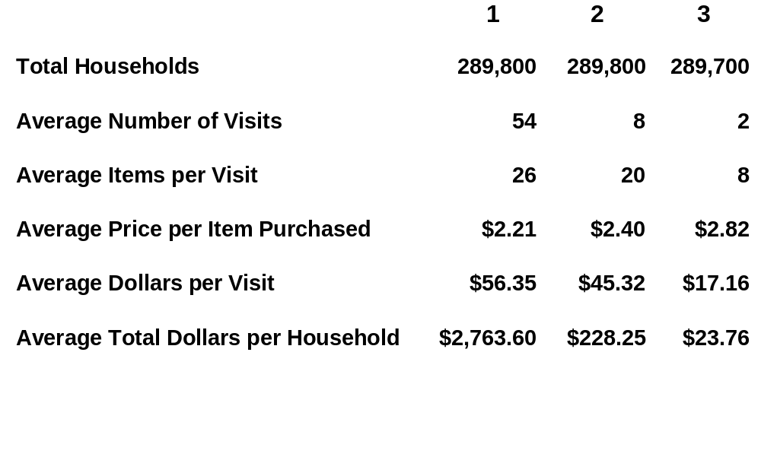
Consumer Relationship Management: Frequent Shopper Programs - Consumer Dynamics (Sample)
Diagnose
Issues
Establish
Baseline
Assess
Opportunities
Develop
Improvements
Implement
Customer
Relationship
Initiatives
Embed
New Program
and
Processes
Understanding Consumer Dynamics to Drive Traffic and Transactions
Shopper Tiers

Slide 59
Consumer Relationship Management: Household and Basket Penetration - Department and Subcategory (Sample)
Diagnose
Issues
Establish
Baseline
Assess
Opportunities
Develop
Improvements
Implement
Customer
Relationship
Initiatives
Embed
New Program
and
Processes
Percentage of Households that Purchased in the Category
Percentage of Baskets Containing the Category
100
90
80
70
60
50
Percentage
40
30
20
10
0
BEEF
MILK
JUICES
COFFEE
PORK
SOUPS
CEREAL
CHEESE
BREADS
CHICKEN
ICE CREAM
SOFT DRINKS
BEER-&-ALE
PHARMACY
COOKING VEG
SALTY SNACKS
VEG & FRUITS
JUICE DRINKS
PACKAGED-MEAT
PREPARED-FOODS
Household
Basket

Slide 60
Customer Relationship Management: Leverage Customer Insights (Focus Areas)
Diagnose
Issues
Establish
Baseline
Assess
Opportunities
Develop
Improvements
Implement
Customer
Relationship
Initiatives
Embed
New Program
and
Processes
Market
Opportunity
Analysis
Competitor
Evaluation
Customer
Evaluation
Financial Analysis
Activity
Based Costing
Training
The
Retailer
Advanced
Consumer
Insight
Efficient
Replenishment
Supply
Chain Initiatives
Pricing
Analysis
Scan Based
Trading
Efficient
Assortment
Promotion &
Advertising
Feature Analysis

Slide 61
Customer Relationship Management: Advanced Consumer Insights - Based on Frequent Shopper Analytics
Diagnose
Issues
Establish
Baseline
Assess
Opportunities
Develop
Improvements
Implement
Customer
Relationship
Initiatives
Embed
New Program
and
Processes
Frequent Shopper Analytics….
  Consumers
    Build/Retain Loyalty
    Share of Requirements
    Customer Profiling
    Marketing Programs for Key Segments
    Predictive Modeling of Lost Shoppers
    Transaction/Traffic Building Strategies
  Manufacturers
    Consumer Driven Efficient Assortment
    Trade Promotion Effectiveness
    Feature Ad Analysis
    Marketing Mix Efficiency
    New Product Introduction
  Store Operations
    Product Adjacencies
    Display Optimization
    Price Point Analysis
    Store Level Micromarketing

Slide 62
Customer Relationship Management: POS Business Intelligence System Capabilities (Sample)
Diagnose
Issues
Establish
Baseline
Assess
Opportunities
Develop
Improvements
Implement
Customer
Relationship
Initiatives
Embed
New Program
and
Processes
Datamining for Consumer Centric Insight and Action
Capabilities
Aggregate
POS Data
Transaction
Scan Data
Frequent
Shopper Data
Store Segmentation
✓
✓
✓
Causal Response
✓
✓
✓
Promotion/Tradefund Effectiveness
✓
✓
✓
Store Level Planograms
✓
✓
✓
Space-to-Sales/Productivity
✓
✓
✓
Consumer Solution Marketing
✓
✓
Shopper Segmentation
✓
✓
Time of Purchase
✓
✓
Out of Stock Triggers
✓
✓
Feature Analysis
✓
✓
Efficient Assortment
✓
✓
Category Sales/Basket Penetration
✓
✓
Product Interactions
✓
✓
Longitudinal Tracking of Individual Households
✓
Consumer Relationship Marketing
✓
New Product Screening
✓
Category/Brand/Household Penetration
✓
Loyalty/Switching Analysis
✓

Slide 63
Why You Need to Conduct a Customer Relationship Diagnostic
Ask yourself the following questions:
  How do I know if a new item introduction is right for my customers?
  Who are my best customers?
  How do I build loyalty with my best customers?
  What is the best traffic building strategy for me?
  How do different customer groups differ in purchase transaction size?
  What are the correct price points to use to satisfy the key customer segments?
  What can I change store specific to micro-market to these key customer segments?
  How do different customer groups vary in frequency of visits and departments penetration?
If you are not comfortable answering all these questions, a Customer Relationship Diagnostic from PricewaterhouseCoopers would be very valuable to your organization

Slide 64

Sample Resumes of
Supermarket Practitioners


Slide 65
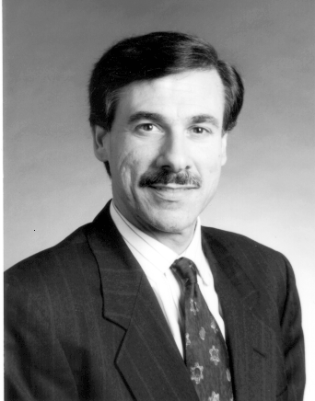
Professional Qualifications
Herb Kleinberger is a Principal of Pricewaterhouse-Coopers and Global Leader of the Retail Industry Group. Based in New York, Mr. Kleinberger specializes in business process improvement in retail and apparel companies. He works with clients to evaluate and transform their operations, organizations and systems in order to improve customer service and profitability. This work often involves the preparation of strategic information systems plans and the development of software aimed at improving inventory management and merchandise control.
Mr. Kleinberger's consulting activities have focused on the buying process, merchandise planning and distribution, supply chain management and performance measurement. He has also directed strategic positioning studies, acquisition reviews and cost reduction studies.
Highlights of Mr. Kleinberger's consulting activities have included:
Directing the worldwide evaluation of the operations, processes and use of information technology at a multinational retail holding company. Results were used to drive the preparation of strategic changes at each operating company.
Planning for the consolidation of two major multi-divisional retail companies' central office activities and management information systems.
Developing a comprehensive strategic information systems plan for one of the nation's largest retail companies. This plan was tied into a major turnaround and restructuring of the business.
He is a member of the Retail Financial Executives Association, the Wharton Club of New York, and the Institute for the Certification of Computer Professionals.
Mr. Kleinberger holds a bachelor of arts degree in computer science from the State University of New York and an M.B.A. degree in finance from the University of Pennsylvania Wharton School.
HERB KLEINBERGER
Principal
PricewaterhouseCoopers

Slide 66
Professional Qualifications
Jack Pomarole is a Principal with PricewaterhouseCoopers. Based in Boston, Massachusetts, Mr. Pomarole specializes in assisting clients in the area of information technology.
Mr. Pomarole has over twenty years of diversified experience in the design, development, and implementation of retail technology, and the associated business process improvements.
His work with clients have ranged from the development of Strategic Information Systems Plans to the selection and implementation of complex retail solutions. Viewing technology as a business“enabler”, Mr. Pomarole focuses on understanding the business drivers supporting the new technology.
In his recent work with clients Mr. Pomarole has been responsible for the development of an E-Biz strategy for one of the worlds leading department stores. The work included the development of an E-Biz strategy that included Content Strategy, Web Design, and Back Office support.
In addition he has recently completed the successful implementation of an ERP solution for a leading retailer. The work initially required the development of a 2-3 year information systems plan which established a direction for hardware and software acquisition, organizational realignment and capital expenditures. The final stage was the implementation of new Financial, HR/Payroll, and Supply Chain/ Merchandising applications. The corresponding business process improvements has allowed the retailer to gain the business benefit associated with the introduction of the new technology.
Mr. Pomarole holds a Bachelor degree from Suffolk University.
JACK POMAROLE
Principal
PricewaterhouseCoopers

Slide 67
Professional Qualifications
Garry A. Birkhofer is a Director with PricewaterhouseCoopers, based in New York, NY. Mr. Birkhofer leads consulting engagements that focus primarily on improving performance and increasing shareholder return through implementation of client specific best practices in the supermarket industry.
Mr. Birkhofer specializes in helping clients address operational challenges including shrink management, improved flow of goods, labor management, and utlization of technology solutions. By focusing on process improvement and utilizing a lab store methodology, he helps companies develop tactics that are integrated with overall strategies and supported by the people at store level. Garry helps retailers to redesign core business processes that improve customer satisfaction, lower costs, improve quality, with an approach that creates greater buy-in throughout the organization.
Garry is able to bring twenty years of industry experience and seven years of consulting experience to his consulting engagements.
He has helped many of the top seventy five supermarket retailers in the US reengineer basic business processes and develop integrated programs that encourage alignment of people, processes and technology. Mr. Birkhofer has also completed engagements with retailers in the UK Canada and South America.
In the supermarket vertical Mr. Birkhofer has successfully directed the development of new processes that have improved profitability and productivity in all aspects of operations. Clients have included limited assortment formats, to upscale perishable operations, to big box superstores. Clients have ranged in size from 300 million to 45 billion in annual sales. In most cases his work involved the implementation of technology or the revision of processes to realize the full potential of investments in IT solutions such as CAO, EAS and automated scheduling.
Mr. Birkhofer holds a bachelor of business administration degree in marketing from the University of Iowa, Iowa City, IA.
GARRY A. BIRHKOFER
Director
PricewaterhouseCoopers

Slide 68
Professional Qualifications
Ms. Kovacik is a Principal Consultant with the New York office of PricewaterhouseCoopers, LLP.
Ms. Kovacik specializes in developing information technology solutions for retail clients, with over 12 years of dedicated retail industry experience. Her background in application development for the retail industry makes her a key contributor on projects ranging from strategic planning, requirements definition and application implementation. Since joining PricewaterhouseCoopers Ms. Kovacik has been actively involved in a number of projects for a wide range of clients.
Most recently, Ms. Kovacik lead a successful ERP implementation project for a $3 billion discount retailer with over 3,500 locations. This multi-phased engagement focused on the replacement of core mainframe applications with the Retek suite of applications. The project management approach emphasized the structured PwC methodology, which integrated change management and information technology components.
Within the scope of the Strategic Information Systems Planning projects, Ms. Kovacik was responsible for analysis of the current applications, the formulation of the target application architectures and the development of the implementation strategies. The three to five year plans incorporated detailed recommendations for packaged software implementation, technology architecture and organizational development. These studies also provided the retailer with business cases for the recommended implementation scenarios. Ms. Kovacik was responsible for developing detailed resource requirements including capital expenditures, budget expense, staffing levels and estimated benefits.
Ms. Kovacik holds a Bachelor of Fine Arts degree and a Masters in Business Administration from Concordia University, Montreal, Canada.
TANYA KOVACIK
Principal Consultant
PricewaterhouseCoopers

Slide 69
PricewaterhouseCoopers
Supermarket Citations


Slide 70
Appendix II.
Citations & Corporate References

Slide 71
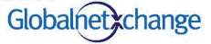
Our Qualifications - Recent Consulting Engagements
PwC was engaged to help GNX incubate the business by leveraging PwC resources to expedite operational execution and grow GNX membership. In addition, PwC is expected to provide support to GNX members by serving as their preferred implementation partner.
Key Business Requirements
Developing functionality for the GNX site
Aggressively recruiting members in order to be the leading B2B global retail exchange
Building an organization to support growth and speed to market
eMarket
Retail
Solutions
What We Did
Developed strategic direction and designed technical architecture
Conducted member value assessments
Led product development efforts and developed implementation plans
Selected Oracle as the platform provider for the marketplace
Results
Conducted transaction volume worth over $110 million as of August 2000
Hosted 51 auctions (indirect and direct) for members generating over $13 million in savings to date
Supply chain collaboration functionality piloted in Q4 of 2000

Slide 72
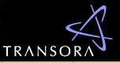
Our Qualifications - Recent Consulting Engagements
PwC initially was engaged by a consortium of leading consumer products companies to formulate the strategy and business case for Transora, the largest global B2B eMarket. Subsequently, PwC helped operationalize the eMarket. PwC currently is acting as a primary developer of the eMarket technology infrastructure and a preferred integrator for members.
Key Business Requirements
Balance speed to market with robust functionality and services
Manage alliances and partnerships with vendors and other organizations
Design processes that accommodate Transora’s rapid growth in the global market
Obtain the right human and technical resources to drive the necessary speed to market
Maintain communications both with investor and non-investor communities and the media
Global
B2B
Marketplace
What We Did
PricewaterhouseCoopers was integral in:
Formulating the concept, driving membership, designing the strategy, and formulating the business plan, tax structure, ownership structure, and organizational structure of the exchange
Assisting Transora in developing seven working pilots around key services including a digital item catalog, promotion and order management, strategic sourcing, and eSourcing through reverse auctions
Results
As an open, standards-based, industry-led B2B eMarket, Transora is planning to deliver services to all participants in the following areas:
  Procurement
  Supply Chain
  Retail
Through innovative services Transora is designed to help suppliers, manufacturers, and retailers optimize business productivity and transform value chain operations, as well as provide an environment for collaborative knowledge transfer.
Financial Services
Content, Community, and Communication

Slide 73
Our Qualifications - Recent Consulting Engagements
Southwest Supermarket Retailer - Process Improvement
PRIMARY AREA OF FOCUS: Center Store & Perimeter Departments
Key Business Issues
Develop client specific replenishment, processing, stocking and conditioning best practices for grocery, frozen, dairy, and HBC/GM
Establish inventory reduction best practices without compromising sales
Develop sub-department best practices that address both sales and shrink management
Develop an expanded approach to Assistant Manager roles with more specific accountabilities
Test an approach to optimize department scheduling to ensure peak presentation and service levels
Develop a total performance management program
Develop a total store shrink management program to increase awareness in all sub-departments
Quantify savings in labor, reductions in shrink, and improvement in inventory as inputs to a business case to estimate benefits for the total organization
Retail
Supermarket
Chain
What We Did
Execute a Laboratory Store Project utilizing two store locations to test industry best practices involving center store, perimeter departments, and shrink management
Involve store associates in the development and testing of initiatives through functional Action Teams
Measure project results by establishing base measures and goals through the development of Key Performance Indicators
Develop a comprehensive operational training guide to ensure a successful chain-wide rollout of best practice initiatives
Recommend an approach for rollout of initiatives to the Rollout Stores for Phase 2 based on the Lab Store results
Results
Developed sub-department shrink control measures by documenting daily known product loss and heightening awareness among all store personnel
Developed a customer service initiative in the form of schedule optimization during peak business hours
Created department specific Key Performance Indicators to measure the project results
Created a “future state” Store organizational design with revised assistant manager roles, responsibilities, and reporting structures
Created an Operational Improvement Binder on Lab Store best practice initiatives

Slide 74
Our Qualifications - Recent Consulting Engagements
United Kingdom Supermarket Retailer - Process Improvement
PRIMARY AREA OF FOCUS: Front-end, center store, perishables, and store management structure
Key Business Issues
Reverse downward sales spiral
Identify barriers to achieving operational excellence
Establish consistent retail execution
Reduce the cost of operations
Reduce inventory on hand
Develop uniform best practices to leverage across chain
Reengineer existing store processes
Establish improved store management structure
Retail
Supermarket
Chain
What We Did
Conduct a comprehensive store diagnostic at 7 representative locations to identify opportunities to evaluate the existing work methods being employed
Measure out of stock incidence & translate to potential increased sales and inventory management opportunity
Conduct scan integrity tests to assess gross margin impact of pricing errors at the checkout and benchmarked key performance measures
Develop internal and external best practices and implemented performance management
Create a customized management structure tailored to meet the needs of the specific store types operated
Results
Identified excess levels of backroom inventory that facilitated a change to the “forced” distribution of goods
Improved front-end / cash office practices
Created an enhanced store organization management structure that reduced cost and improved efficiency
Initiated a change in both corporate management style and leadership to foster empowered store staffs

Slide 75
Our Qualifications - Recent Consulting Engagements
East Coast Supermarket Retailer - Shrink Management
PRIMARY AREA OF FOCUS: Shrink Management Assessment - total company
Key Business Issues
Identify root causes of shrink
Assess the shrink management practices
Understand the controls for supply chain shrink
Determine what Key Performance Indicators are used to measure impact of shrink
Compare existing practices to industry best practices
Benchmark existing results versus industry averages and top performers
Retail
Supermarket
Chain
What We Did
Conducted 63 Interviews of key executives, directors, store personnel
Conducted site visits to twelve stores and three distribution centers
Reviewed support functions of Category Management,Procurement, IT, Finance, Accounting, HR, Loss Prevention
Review key financial data
Review data flow processes
Review key performance indicators
Review past shrink meeting progress and activities
Held brainstorming session with store associates to understand shrink concerns
Results
Process map for shrink occurrences by category
Detailed findings report covering People, Process and Technology by business function
Benchmarks versus industry average and top performers
Tactical and strategic recommendations on shrink management
Detailed process recommendations for future improvement
Quantification of shrink reduction opportunities by category

Slide 76
Our Qualifications - Recent Consulting Engagements
East Coast Supermarket Retailer - Shrink Management
PRIMARY AREA OF FOCUS: Front-end, center store & fresh departments
Key Business Issues
Establish an employee driven focus to improve program effectiveness
Identify and define the root causes of shrink
Implement shrink management best practices
Reduce and control store shrink through new processes and procedures
Develop Key Performance Indicators to measure impact of new shrink processes
Retail
Supermarket
Chain
What We Did
Execute a Lab Store Program to test and develop new client specific “Best Practices” that support improved “Shrink Management”
Create the “Bottom-Up” involvement and buy-in to the change management process by the management and employees in the store through the use of Action Teams
Test Shrink Initiatives and measure the results using Key Performance Indicators
Develop a training guide to take successful initiatives to additional Lab and Pilot Store
Results
Achieved higher scanning percent. An increase of 0.93%
Reduced not on files at the Point of sale over 84%
Reduced store damages & reclaims by 52%
Reduced center store out-of-stocks by 59.5%
Reduced center store backroom inventory by 45.5%
Improved grocery gross margin by 2 points
Reduced center store shrink by 1.0%
Reduced dairy / frozen overstock by 38%
Reduced cigarette on hand inventory by 16%
Improved cigarette inventory turns by 2.6
Reduced beer / wine inventory dollars by 18%
Improved beer / wine inventory turns by 8.5

Slide 77
Our Qualifications - Recent Consulting Engagements
Major Discount Retailer - Scheduling and Standards
PRIMARY AREA OF FOCUS: Front End Productivity and Customer Service
Key Business Issues
Absence of established labor standards and inconsistent cashier work methods
Existing cashier productivity metric inaccurate and skepticism surrounding the ability to use POS metrics
Variety of existing checkout equipment configurations and recency of new checkout configuration installation
Urgent need to reduce the cost of operations
Desire to dedicate less space to Front-end checkout area
Identification of barriers to achieving operating excellence
Major Discount Retailer
What We Did
Conduct comprehensive time study analysis of cashier work methods at 9 different representative store locations to establish performance standards
Analyze the POS generated Transaction Log data for 22 stores to supplement and correlate with the time study observations
Conduct standard order observations at 9 different locations to create a controlled environment in which optimum cashier productivity could be observed
Evaluate the existing work methods being employed
Identify cashier productivity and customer service inhibitors as noted by the time study observers
Assess the effectiveness of the current cashier performance metric being utilized
Results
Completed over 3,500 elemental time study observations at 9 different store locations
Analyzed in excess of 5 million individual customer transactions via the POS generated T-log data to supplement the time study data collected
Persuaded the client to abandon the prior cashier productivity metric in favor of a proposed newer version that was more
Identified a 2% scan integrity improvement opportunity at the checkout
Improved front-end / cash office practices

Slide 78
Our Qualifications - Recent Consulting Engagements
Retail Supermarket Chain - Category Management
PRIMARY AREA OF FOCUS: Center Store Categories
Key Business Issues
Reduce the cost of operations and reduce inventory on hand
Develop uniform best practices to leverage across all stores and identify barriers to achieving operational excellence
Improve labor utilization in perishable departments
Reengineer existing store processes
Identify and develop new store best practices / processes
Establish consistent retail execution
Retail
Supermarket
Chain
What We Did
Conduct an enterprise wide diagnostic to surface expense reduction opportunities
Benchmark key performance measures Vs industry
Develop and test new process improvements in a Lab Store environment
Facilitate workshops and brainstorming sessions to support an associate driven methodology
Conduct interviews with key management and staff to identify challenges and solicit buy-in
Encourage employee involvement through participation
Develop internal and external best practices
Implement performance management and created a best practice training guide / program
Results
Reduced store operating costs and improved HBC inventory days on hand
Reduced dry grocery backroom inventory and streamlined flow of goods process
Reduced center store out-of-stocks and implemented operational best practices
Eliminated non-value added processes and developed customer driven work schedules
Reengineered current store processes and created detailed definitions of new processes
Developed consistent retail execution and operating standards through a comprehensive training guide

Slide 79
Our Qualifications - Recent Consulting Engagements
J Sainsbury Relationship Marketing
PwC was engaged was engaged by this leading U.K.-based supermarket retailer to lead the analysis, specification, design and implementation of the business processes, IT infrastructure, and analytics required for Relationship and Local Marketing Groups.
Key Business Requirements
Provide program management and technical and analytical resource
Lead analysis, specification, design, and implementation
Business processes, IT infrastructure, and analytics for Relationship and Local Marketing Groups
Customer
Relationship
Marketing
What We Did
Design the future business processes and analytical and IT requirements
Manage the current processes
Coordinate the activities between two marketing teams, two mailing houses, internal data warehousing, and Business Insights team
Design a closed loop marketing application
Results
Integrated pre-campaign planning, campaign execution, and post-campaign reporting processes
Automation of multiple steps freed resources to perform ad hoc added value analysis

Slide 80
I. Introduction-
Shrink Diagnostic Scope and Objectives
Shrink Diagnostic Scope
  Merchandising / Procurement
  Store Operations
  Distribution Center
  Accounting and Finance
  Information Technology
  Loss Prevention
  Human Resources / Training
Shrink Diagnostic Objectives:
  Review the current Inventory Management Program
  Identify any gaps in process, people, and technology that contribute to current shrink results
  Identify additional shrink management opportunities and benefits
  Develop recommendations for next steps
  Benchmark Duane Reade shrink performance versus comparable retailers

Slide 81
I. Introduction-
Shrink Diagnostic Approach
Approach
  Our team focused on understanding the current state at Duane Reade to determine if there are additional shrink management opportunities.
  Our holistic approach of reviewing end to end processes considers the cumulative impact of decisions in all functional areas that impact shrink.
  The team has interpreted our observations and interview findings to compare actual practices to corporate expectations.
  PwC has identified additional shrink management opportunities and provided recommendations on short term and strategic initiatives.
  During the diagnostic our team:
    Conducted formal site visits to three store locations and visited fifteen additional store locations.
    Observed the truck receiving and processing process at two locations.
    Toured the distribution center.
    Conducted over 50 interviews with HQ management, staff and at store management.
    Reviewed key financial processes and data flows.
    Reviewed information technology capabilities and data flow processes.
    Reviewed key performance metrics that relate to shrink management.
    Completed a high level bench-marking analysis to quantify potential benefit ranges.

Slide 82
I. Introduction -
Definition of Shrink Types
Within the diagnostic our team focused on three types of shrink and those types are defined below:
Shrink
Execution
Paper
Theft
Execution - Shrink that results from unintentional loss of products or product value due to gaps in performance: i.e., over-ordering, improper handling during the stocking process, multiple touches at the DC and Store, miss rings, miss picks, shorts on loads, and pricing errors
Paper - This type of shrink is the result of accounting errors required to maintain a retail accounting inventory method: i.e., inaccurate inventory counts, errors in accruals, markdowns that aren’t captured properly, date integrity issues that result from item, price and promotion synchronization issues.
Theft - Loss of assets due to the physical loss of product that is intentionally removed from the distribution center, during transit, or store: i.e., internal or external pilferage, sweethearting, grazing and DSD fraud.
Although Paper Shrink is not “real” theft or loss of assets, it does mask the shrink due
to execution and theft issues. Paper Shrink does inhibit management’s ability to isolate
and correct real shrink due to execution and theft issues.

